Slide 1
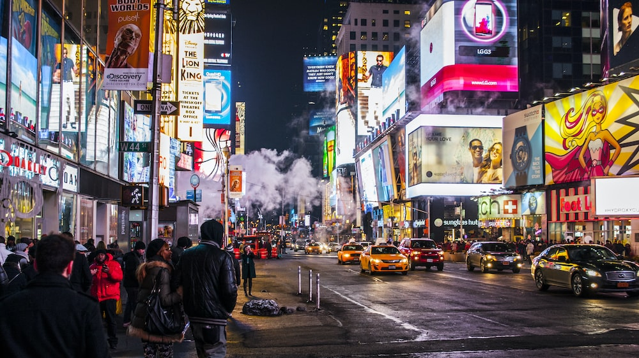

Posterscope
A dentsu company
OOHZone Case Study for
Grand Hyatt Hotel

Slide 2
Mumbai

Slide 3
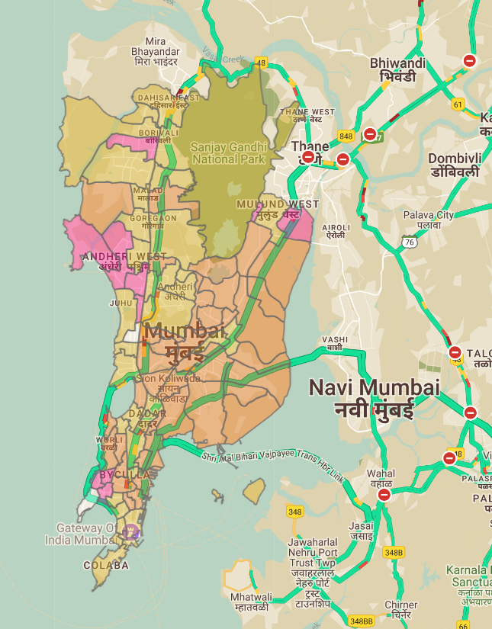
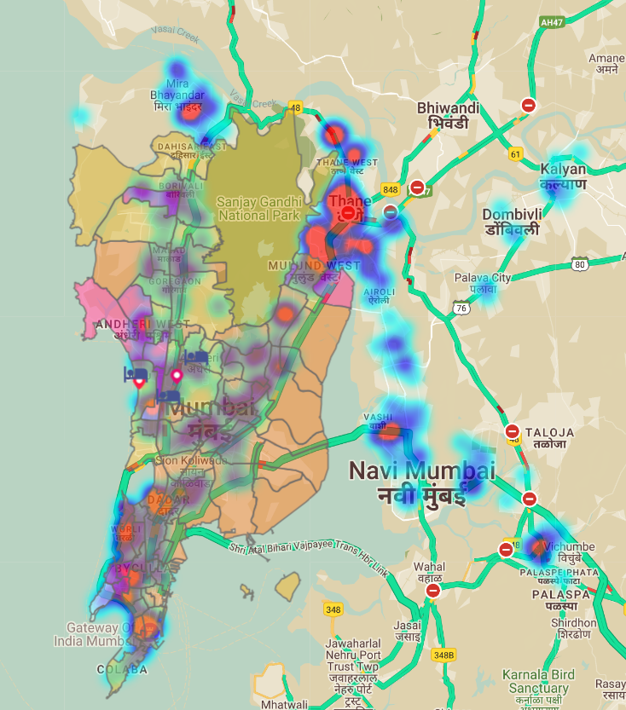
Prosperity Index
Media Sites & Visibility Score
Site Grade : A
Vas :85
Media Sites
Vas :80
Color Priority
White | P 1
Pink | P2
Yellow | P3
Orange | P4
Touch Point: Corporate Park, Super Market & Malls
Notes:
Brief ID :BLYFP1KX

Slide 4
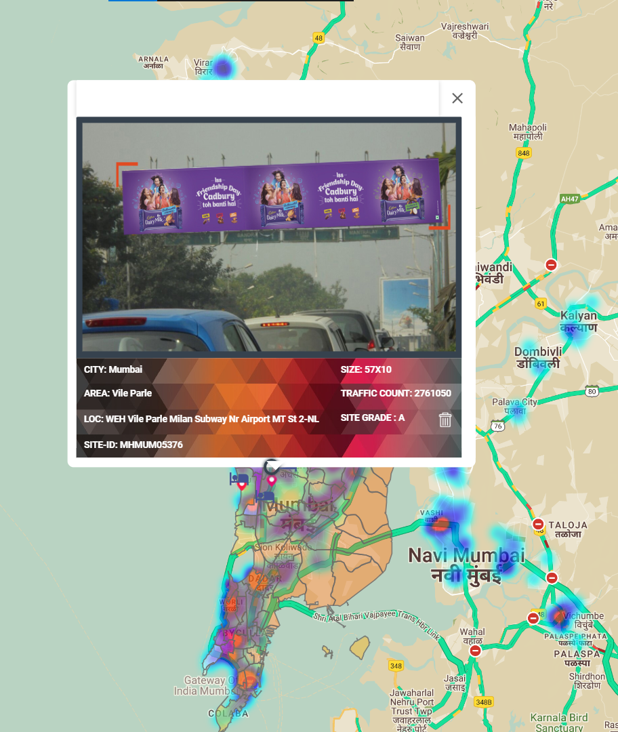
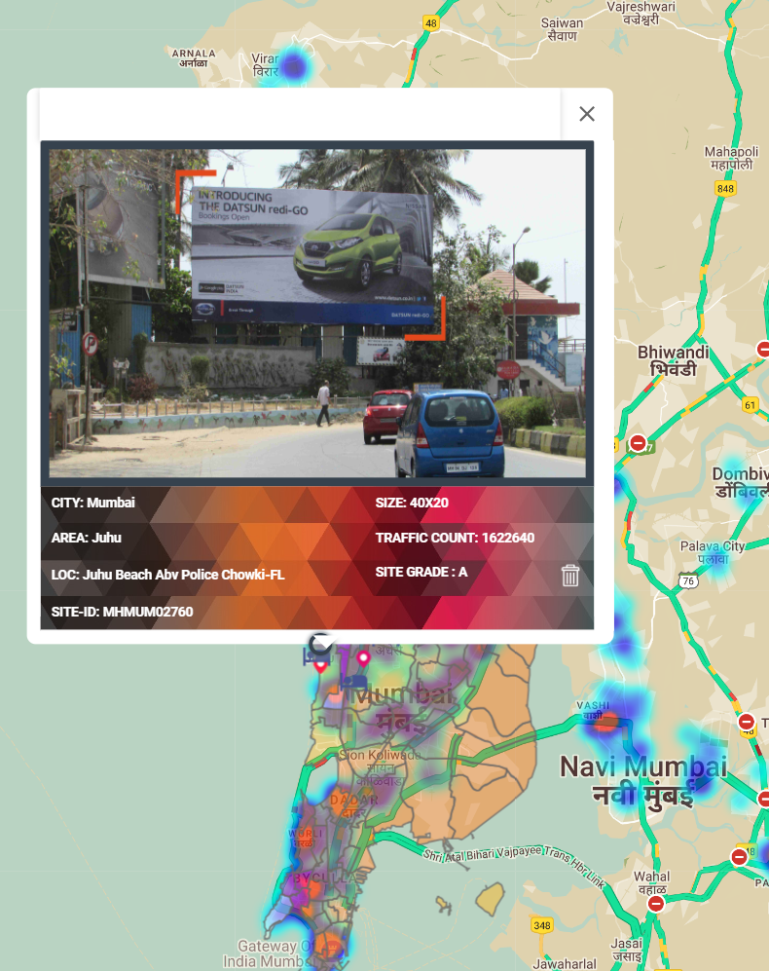
Site ID: MHMUM05376
Location Name: Vile Parle-Airport Road
Site ID :MHMUM02760
Location: Juhu nr Haveli

Slide 5
Delhi & NCR

Slide 6
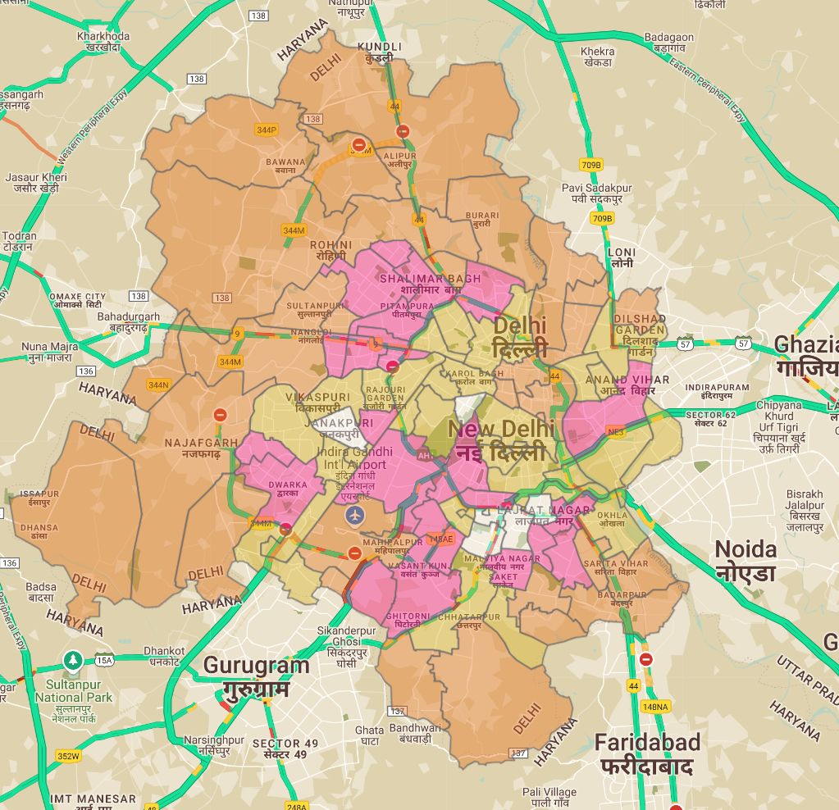
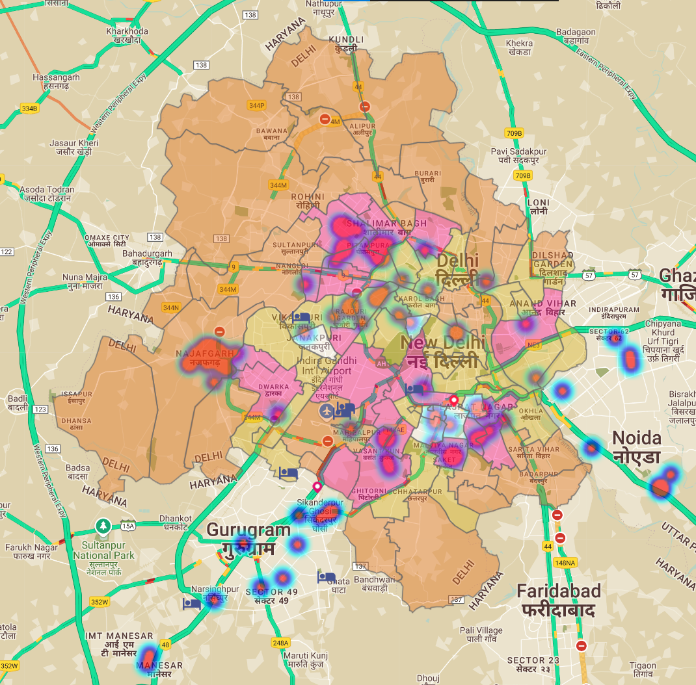
Prosperity Index
Media Sites & Visibility Score
Site Grade : A+ & B+
Vas :95
Media Sites
Colour Priority
White | P 1
Pink | P2
Yellow | P3
Orange | P4
Vas :75
Media Sites
Touch Point: Corporate Park, Super Market & Malls

Slide 7
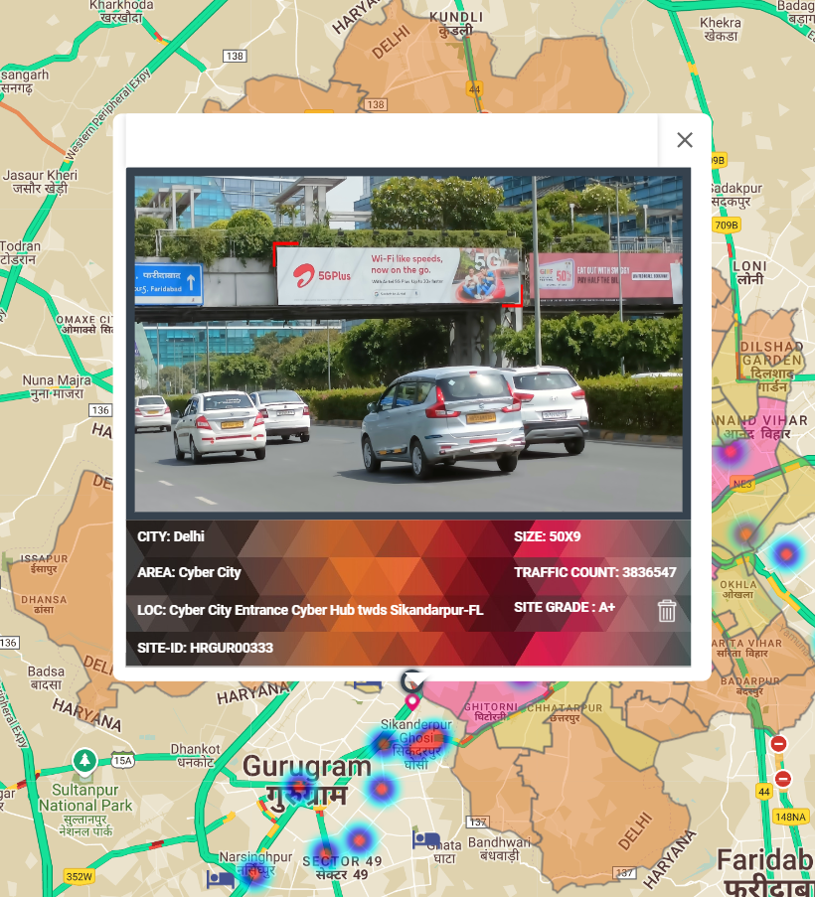
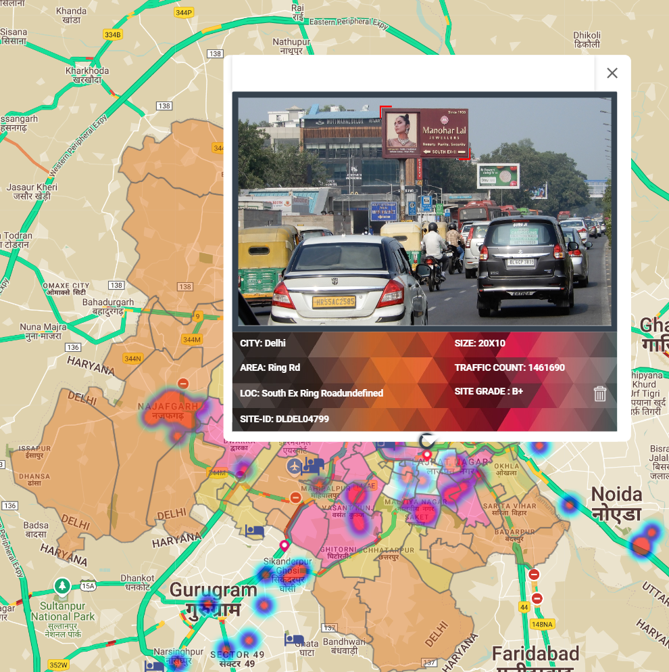
Site ID: HRGUR00333
Location Name: Cyber Hub Entry from Delhi
Site ID: DLDEL04799
Location Name: South toward AIIMS

Slide 8
Bengalore

Slide 9
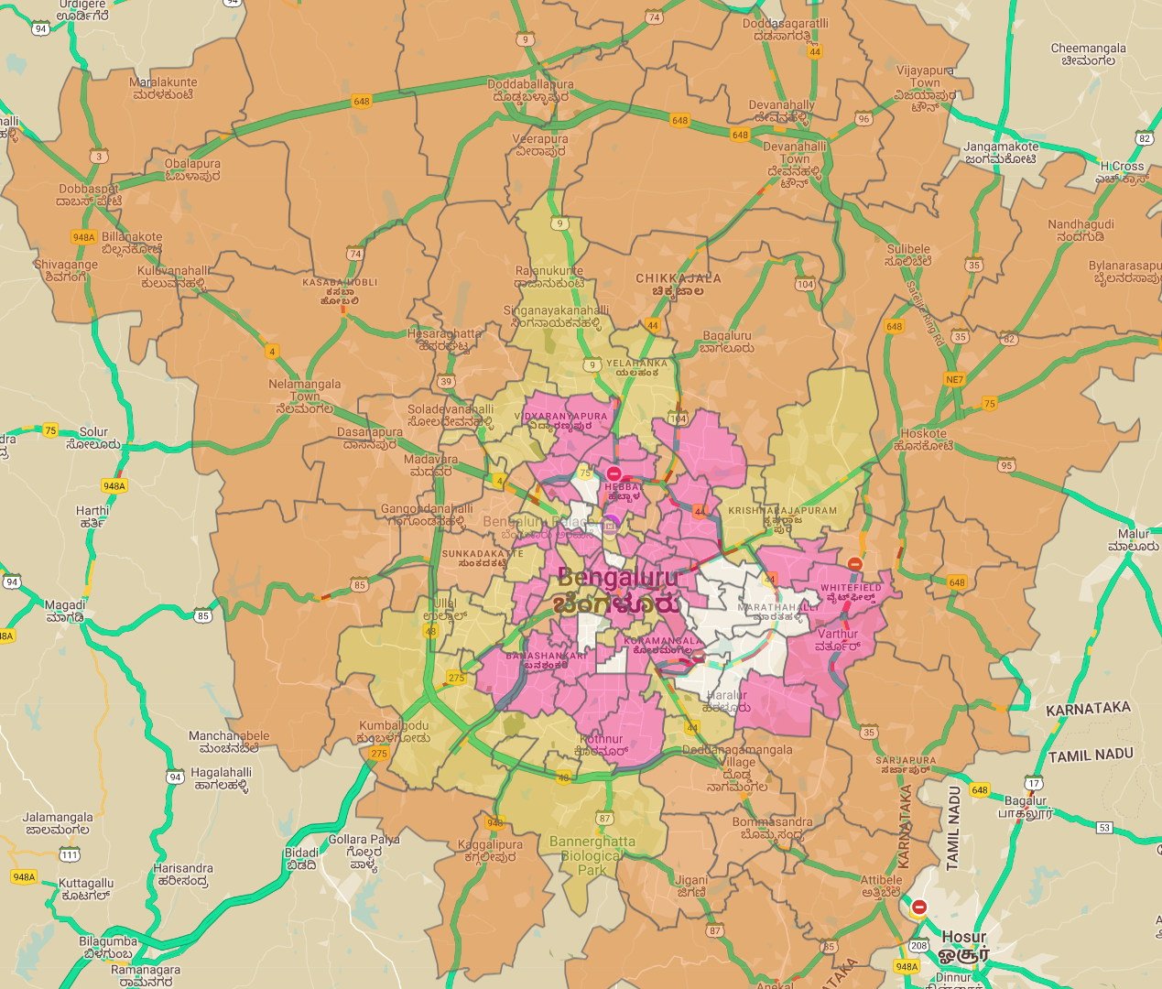
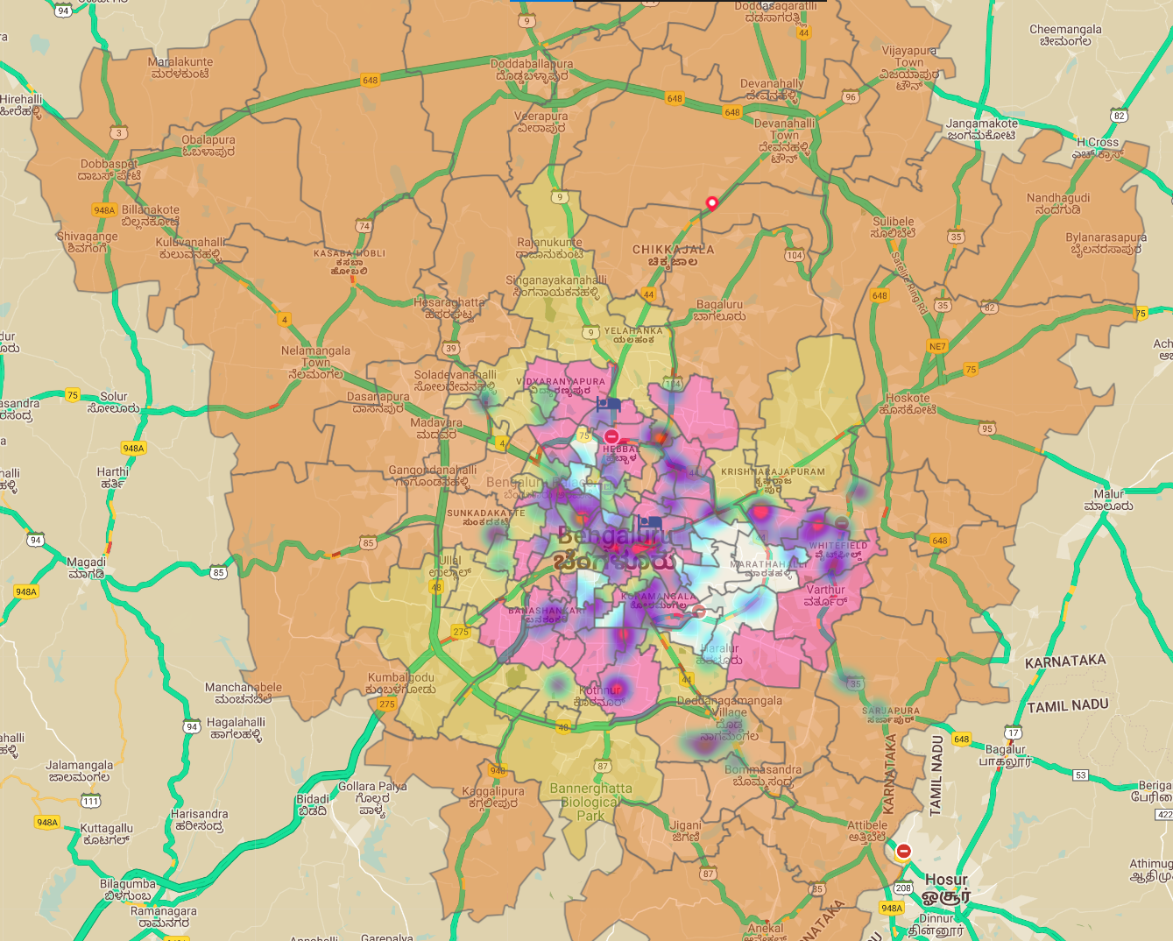
Prosperity Index
Media Sites & Visibility Score
Site Grade : A
Vas :85
Media Sites
Color Priority
White | P 1
Pink | P2
Yellow | P3
Orange | P4
Touch Point: Corporate Park, Super Market & Malls

Slide 10
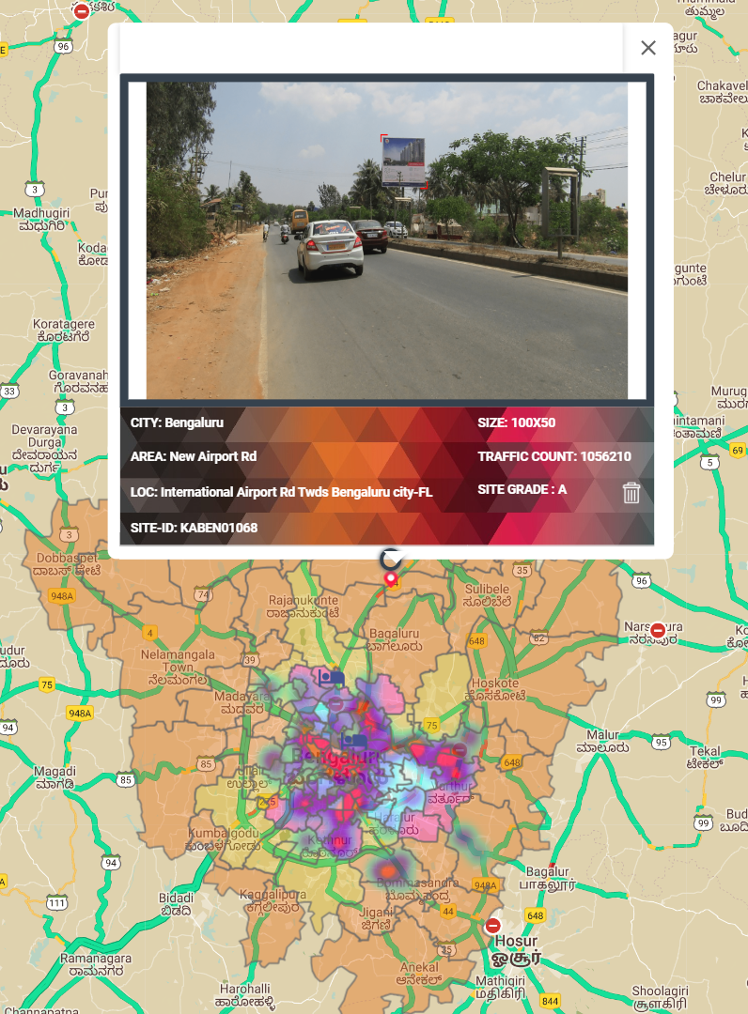
Site ID: KABEN01068
Location Name: Trumpet Flyover -Airport to City

